Slide 1
CACHE DESIGN
Fall 21 project 2
Netra Shah (NPS210000)
Suchith Natraj Javali (SXJ200024)

Slide 2
Contents
Terminologies
Gem5 Setup
Automation using python
Defining Cache parameters
Results
Analysis
Conclusion
Aim of this is project
Design Cache parameters, analyze and identify the optimal configuration considering the trade off between performance and cost

Slide 3
Cache and its importance
Cache is an on chip memory which improves CPU performance since it is much faster and consume lower power than off chip memories by using principle of locality. Caches use SRAM technology.
It is faster than the main memory.
The access time is quite less in comparison to the main memory.
The speed of accessing data increases hence, the CPU works faster.
Moreover, the performance of the CPU also becomes better.

Slide 4
Terminologies
Cache associativity : Measure of how the individual blocks can be placed within cache
Cache size : The physical size of cache memory
Cache block size : The size of each block within each set
Hit : data appears in some block of the cache
Hite Rate: The fraction of memory access found in the cache
Hite Time: Time to find the data in cache
Miss rate : 1-(Hit Rate)
Miss penalty : Time to replace a block in the cache when there is a miss
Average Memory access time (AMAT)
AMAT= Hit time + (Miss rate x Miss penalty)

Slide 5
Gem5 Setup
Accessed Gem5 on ce6304.utdallas.edu server via UTD VPN
Command in terminal :
To access server - “ssh nps210000@ce6304.utdallas.edu”
To copy Gem5 for local directory – cp –rf /usr/local/gem5 /home/nps210000/m5out
To build x86 - scons build/X86/gem5.opt
This would build the “gem5.opt” executable which we will use to run the simulations
CPU Benchmarks Used
458.sjeng
470.lbm
Note: We don’t add any extra parameters unlike project 1 to CPU

Slide 6
Automation using python
We create python script to automate the process of changing cache configuration and run it with all the required combinations
Sample of the script:
benchmark_dir = "~/m5out/benchmarks/Project1_SPEC/470.lbm"
gem5_dir = "~/gem5"
benchmark_script = "./runGem5_470.sh“
associativity = ["1","2"]
for i in associativity:
os.system("gem5/build/X86/gem5.opt -d /home/013/n/np/nps210000/m5out gem5/configs/example/se.py -c ./m5out/benchmarks/Project1_SPEC/458.sjeng/src/benchmark -o ./m5out/benchmarks/Project1_SPEC/458.sjeng/data/test.txt -I 500000000 --cpu-type=TimingSimpleCPU --caches --l2cache --l1d_size=128kB --l1i_size=128kB --l2_size=1MB --l1d_assoc="+i+" --l1i_assoc="+i+" --l2_assoc=1 --cacheline_size=64")

Slide 7
Calculating CPI
We calculate the CPI for the below data in benchmark 470.lbm benchmark:
CPU Model : TimingSimpleCPU (timing)
Cache levels - 2
Separate L1 data and L1 Information
Unified L2
L1 data - 128kB
L1 Information - 128kB
L2 - 1MB
L1 Associativity - 2
L2 Associativity - 1
Block Size - - 64B
Replacement Policy - LRU
Instructions - 50,000,000
L1 miss penalty - 6 cycles
L2 miss penalty - 50 cycles

Slide 8
Formula to calculate CPI
CPI = 1 + ( [(L1i_access*i_miss_num+L1d_access*d_miss_num)*6 + L2_access*l2_miss_num * 50] / Total_Inst_num )
Where
L1i_access Instruction cache overall accesses
i_miss_num Instruction cache overall miss rate
L1d_access Data cache overall accesses
d_miss_num Data cache overall miss rate
L2_access L2 cache overall accesses
l2_miss_num L2 cache overall miss rate
Total_Inst_num Total number of instructions

Slide 9
Calculation :
system.cpu.icache.overall_miss_rate::total 0.000001
system.cpu.icache.overall_accesses::total 740208222
system.cpu.dcache.overall_miss_rate::total 0.033135
system.cpu.dcache.overall_accesses::total 216142322
system.l2.overall_miss_rate::total 0.998695
system.l2.overall_accesses::total 7162452
CPI = 1 + [(740.208222 + 71,61,875.83947)* 6 + (71,53,105.00014 * 50)]/500000000
= 1 + 0.801261892586304
= 1.80126189

Slide 10
Factors affecting cache performance – Cache optimization
Block Size(cache line size):
Size of each block in a set will affect the performance of the CPU
As we increase the size of the block, miss rate decreases as there will be more addresses to search for (using principle of spatial locality) and more data can be loaded
Large block size reduces the compulsory misses.
But, increasing the block size too much increases miss penalty as they reduce the number of blocks in cache.
We will analyze the miss rate of L1 and L2 cache, by keeping all the parameters constant and changing block size(cache line size)
For
L1 data size - 128kB
L1 Information size - 128kB
L2 size - 1MB
L1 Associativity - 2
L2 Associativity - 1

Slide 11
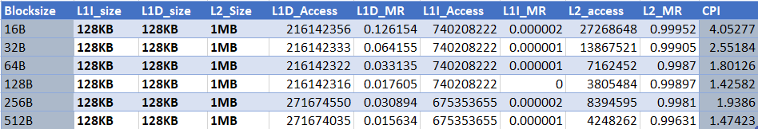
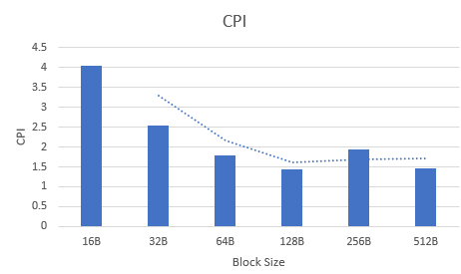
For benchmark 470.lbm

Slide 12
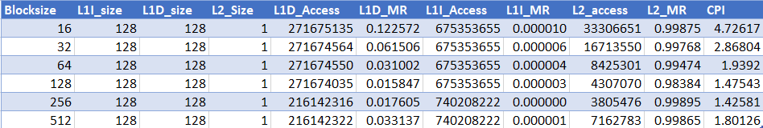
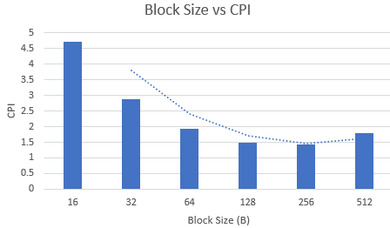
For 458.sjeng benchmark

Slide 13
Analysis
By keeping other parameters constant except block size for both the benchmarks, we observe that:
CPI reduces till a point and then tend to increase. This is because we reduce the compulsory misses as we increase the block size. But beyond some point, number access and miss penalty will increase
Large block also reduces hit latency, decreases the miss rate of L1 and L2 cache as we can observe in the table data
It is better to have large block size but not too big

Slide 14
Effect of cache associativity on cache performance
Associativity
To make efficient use cache space, sets are used which divides the cache into group of blocks.
As we increase the associativity, miss rate is decreased and conflict misses are reduced. CPI is also reduced as we can see from the graph for both the benchmarks
But, increasing the associativity will increase the cost due to extra hardware. This is the reason why fully associative cache are more expensive than direct mapped cache.
Fully associative cache will also increase hit time as data can be anywhere in the cache and need to check every tag of every cache block
By keeping other parameters constant, we shall vary associativity of L1, L2 cache and observe the effect of it on cache miss rate

Slide 15
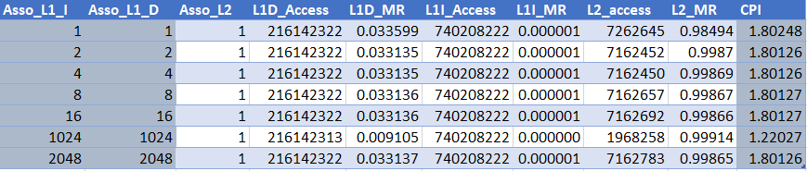
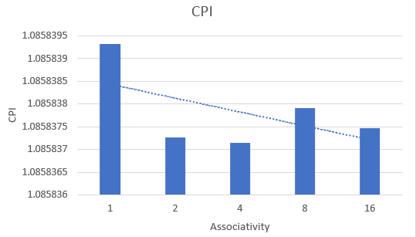
For 470.lbm

Slide 16
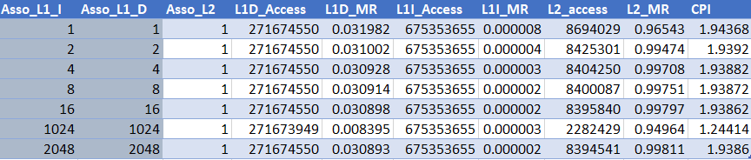
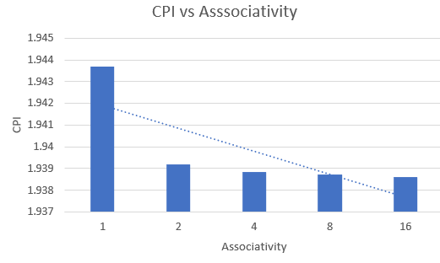
For 458.lbm

Slide 17
Cache Size
Similar to the block size, as we increase the cache size, Miss rate is reduced and hence CPI is also reduced in both the benchmarks
As we increase L1 and L2 cache size, hit rate will increase as more data is present in the cache
But increasing cache size will result in expensive cache which we will observe

Slide 18
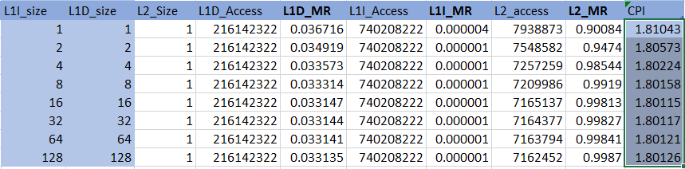
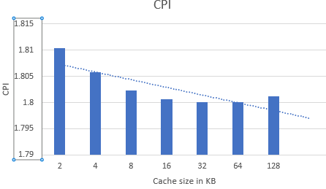
For 470.lbm

Slide 19
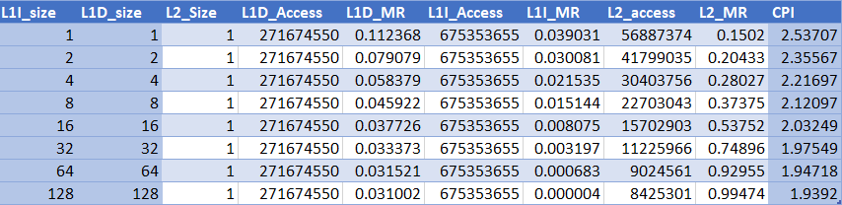
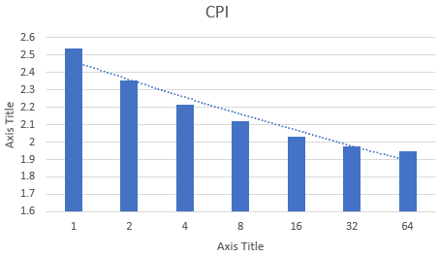
For 458.sjeng

Slide 20
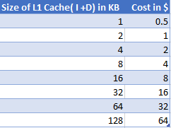

Cost Function
We define cost function for various parts of the cache considering below:
Associativity increases the cost
Doubling the cache size will double the cost
L1 cache is costlier than L2 cache
We have defined cost function considering above listed parameters. Cost will be calculated in dollars. For 1KB of L1 cache, it is defined to cost 0.5$.And for L2 cache it would cost 0.125$. L1 cache has lowest access time but expensive
L2 is cheaper because it is placed away from the chip

Slide 21
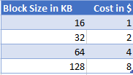
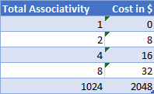

Cost Function for block size, associativity and CPU model
As we increase the block size, cost function defined is increased since we need extra hardware to determine which block is to be used. But this increment is not significant compared to other factors.
Cost is changing associativity plays a major role. As we increase the associativity, cost increases and as it tends to reach full associativity, it becomes maximum. Doubling the associativity will double the cost. Price increases because we need to compare more values to locate the address
We use timing simple CPU in our project. Hence this parameter will be constant 10$ in our analysis

Slide 22
Evaluation function and cost definition
As a generic evaluation function, we define that cost and CPI is inversely proportional.
Cost = Constant /(CPI-1)^2
The above evaluation functions means that to some extent, Cost can be compromised but after some point, tradeoff will be exponential.
Getting lowest CPI is our aim, but for this we need to compromise with the cost of the cache design which is determined by the requirement and necessity.
The constant value might depend on various factors like architecture used, process parameters and CPU type.
To calculate the cost of the various configurations defined, we use weights for each parameter like associativity, block size and cache size

Slide 23
Calculating Cost
To calculate the cost of the cache as defined earlier, we consider below generic formula for this project
We add all the associativity and weigh them 4x except direct mapping which doesn’t incur extra charges
Each KB in L1 will cost 0.5$ whereas in L2 it will cost around 0.125$
Total Cost = (L1 cache size * 0.5)+ (L2 cache size * 0.125) + (Total associativity * 4) + CPU type + (Block size/16)

Slide 24
Optimum CPI
For 458, Total of 300+ configurations were checked
We got the smallest CPI of 1.24 but the cost is very high of 8743$. On the other hand, for least expensive cache of 110$ we got the CPI value of 3.109153.
We got the best optimum value considering cost vs CPI trade off :
L1 Associativity : 2
L2 Associativity : 2
Block Size : 64
L1 Cache size : 64kB
L2 cache size : 512 Kb
CPI : 1.993726045
Cost : 191$

Slide 25
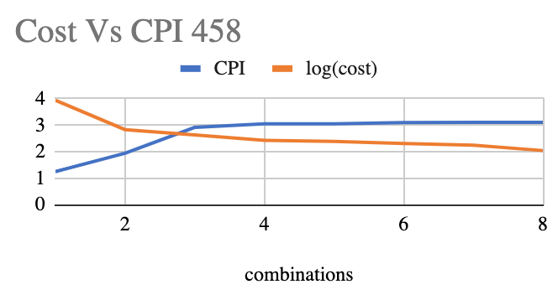
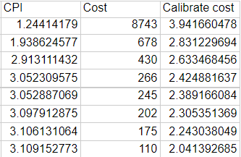
458 CPI vs Cost (logarithmic graph)

Slide 26
Optimum CPI
For 470, Total of 432 combinations were checked
We got the smallest CPI of 1.220 but the cost is very high of 8478$. On the other hand, for least expensive cache of 80$ we got the CPI value of 4.05.
We got the best optimum value considering cost vs CPI trade off :
L1 I Associativity : 2, L1 D Associativity : 4
L2 Associativity : 2
Block Size : 64B
L1 Cache size : 64kB
L2 cache size : 512 KB
CPI : 1.801085
Cost : 128$

Slide 27
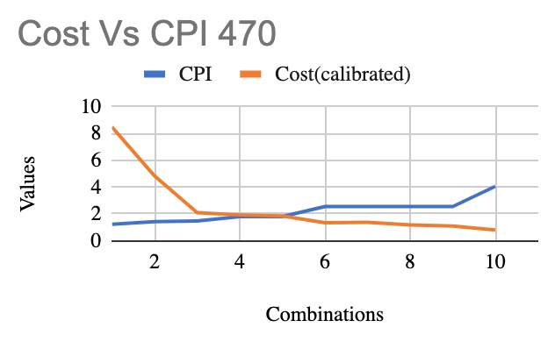
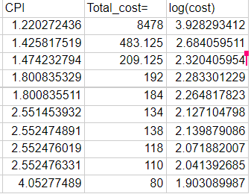
Cost vs CPI for 470.lbm (logarithmic graph)
As we can observe in the graph, as CPI increases, cost decreases
Cost is calibrated(divided by 100) to plot the curve

Slide 28
Conclusion
Cache with higher block size is chosen as it allows the cache to take advantage of spatial locality
High cache size and associativity is always recommended but it comes with the trade off(cost) as we can observe in the total of 800 combinations tried.
Adding one more hierarchy can boost the performance of cache
Increasing associativity for the same L1 cache reduces conflict misses
Observing various factors, 2 optimum Cache design was made in this project for both the benchmarks
Python script which we used to automate the process and 800+ stats file along with all the cost calculation is uploaded along with this ppt

Slide 29
THANK YOU

